Slide 1
Bullying Prevention Workshops Implementing the Bullying Prevention Guidance
Notes:
The aim of this presentation is to give schools an overview of the bullying and prevention guidance and allow them to work in the PB4L team to discuss some specific areas of the guidance. In particular they will be asked to focus on how this work can relate to their current PB4L framework and what are the next steps for their school in terms of bullying prevention.

Slide 2
Workshops overview
The following slides are designed to support the delivery of professional development activities for schools through the 10 Bullying Prevention Workshops available on www.bullyingfreeNZ.co.nz
The materials for each of the workshops will include information about which slides to use for each workshop.
Trainer Slide

Slide 3
Trainer Slide
Notes:
Reminder of the guide that we are looking at today – Schools will have been asked in advance to bring along their copies.

Slide 4
Strategies for dealing with bullying
Preventing | Responding
Direct teaching | Restorative methods
Developing a School ethos | Method of Shared Concern / Undercover teams / Problem solving teams
Developing an anti-bullying policy | Solution Focused Discussions
Wellbeing in schools survey | School sanction systems
Peer mediation | Outside agencies
Workshops 6
Notes:
This slide to help highlight the need to consider the school approaches to both preventing and responding to bullying.
Initially the focus is on how the school works to prevent bullying ( Workshop 4)

Slide 5
Activity: Responding to bullying
Use the Responses to Behaviour handout and the bullying scenarios sheet to discuss possible different responses to the scenarios.
Workshop 6

Slide 6
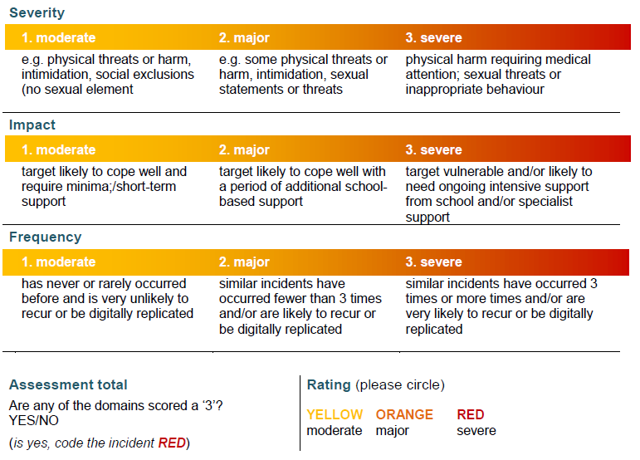
Responding to bullying
Workshop 6

